Slide 1
Chapter 22. Network Layer: Delivery, Forwarding, and Routing
21.1 Delivery
21.2 Forwarding
21.3 Unicast Routing Protocols
21.4 Multicast Routing Protocols

Slide 2
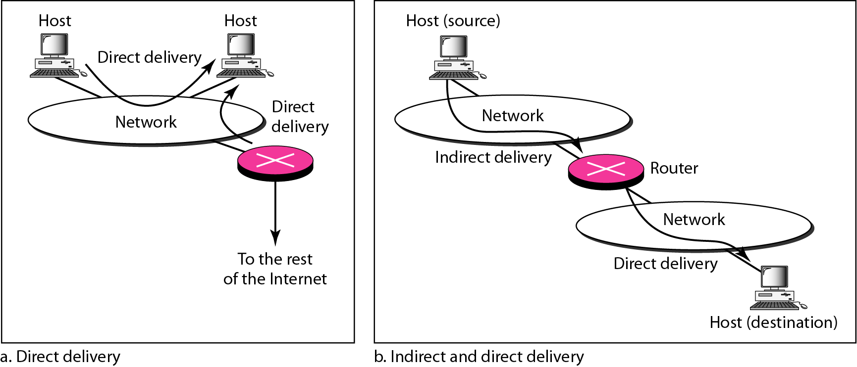
Delivery
The network layer supervises the handling of the packets by the underlying physical networks. We define this handling as the delivery of a packet.
Direct versus Indirect Delivery

Slide 3
Forwarding
Forwarding means to place the packet in its route to its destination.
Forwarding requires a host or a router to have a routing table
Forwarding techniques to make the size of the routing table manageable
Next-hop method versus route method
Network-specific method versus host-specific method
Default method

Slide 4
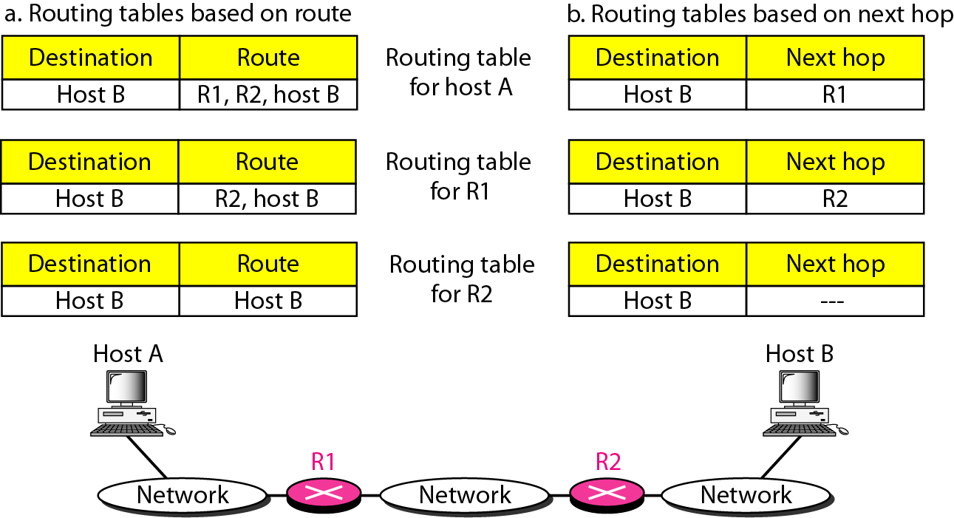
Forwarding Techniques
Route method versus next-hop method

Slide 5
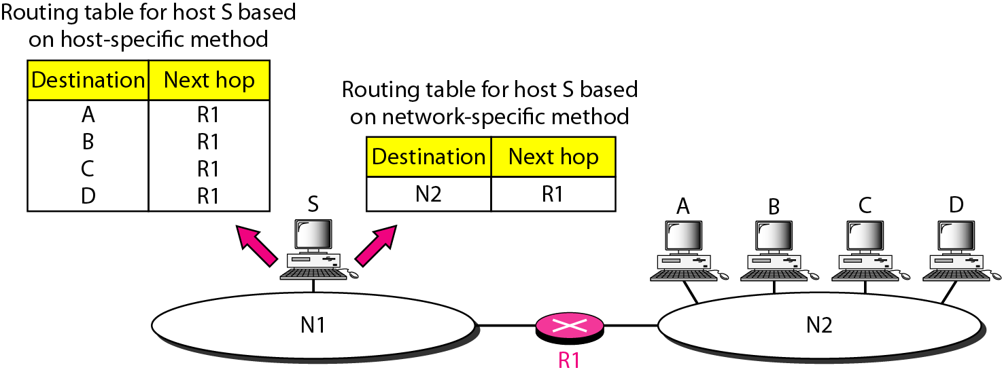
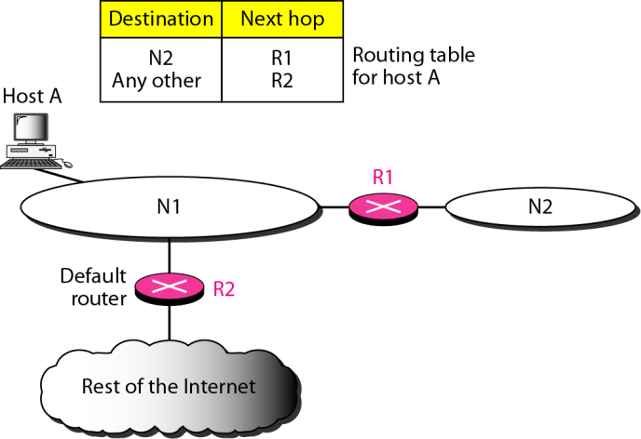
Forwarding Techniques
Host –specific versus network-specific method
Default method

Slide 6
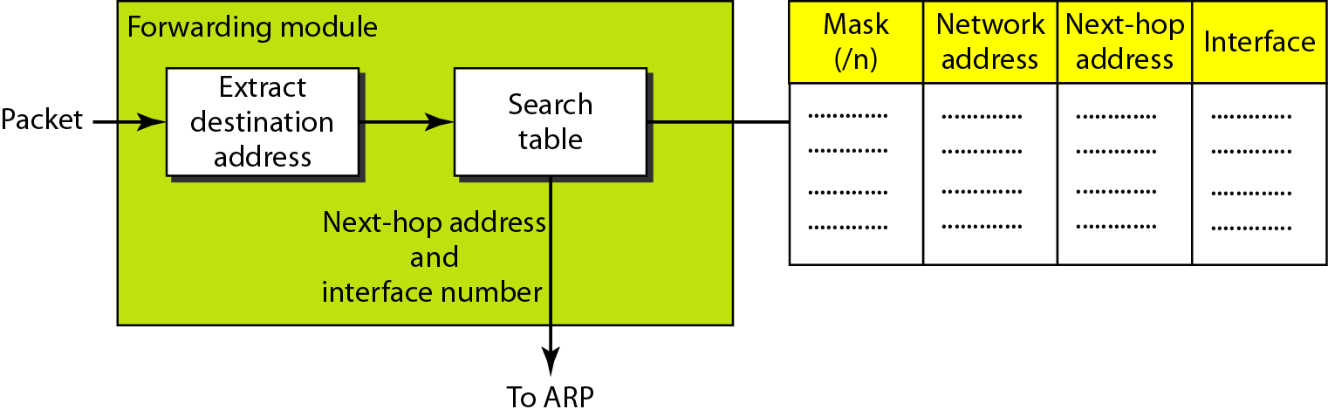
Forwarding Process
In classless addressing, we need at least four columns in a routing table

Slide 7
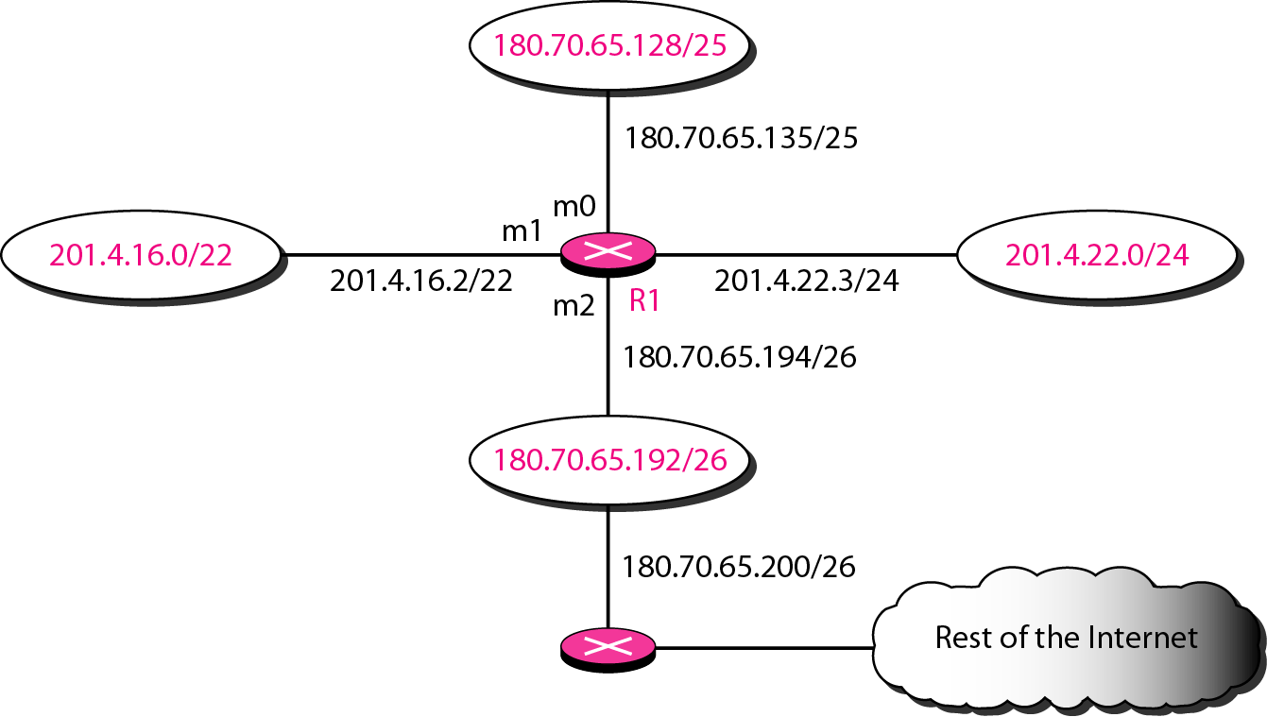
Example
Make a routing table for router R1, using the configuration in Figure

Slide 8
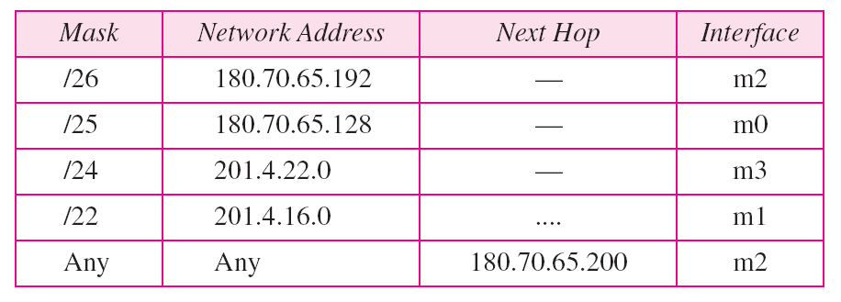
Example
Routing table for router R1
Forwarding process for the destination address 180.70.65.140 ?
Forwarding process for the destination address 18.24.32.78 ?

Slide 9
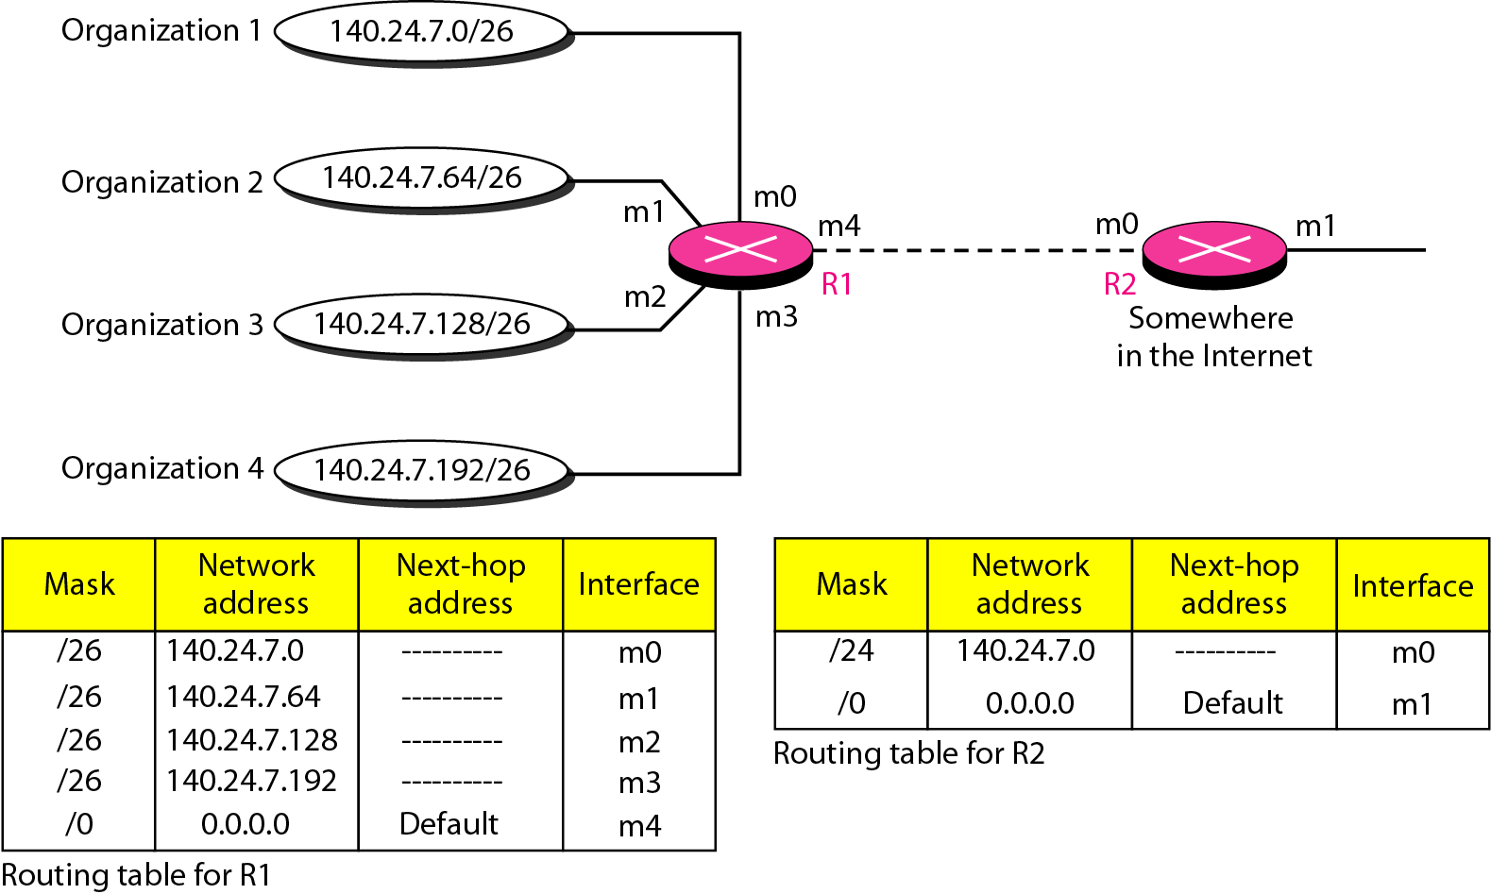
Address Aggregation
Classless addressing increases the number of routing table entries
To alleviate the problem, the address aggregation is used

Slide 10
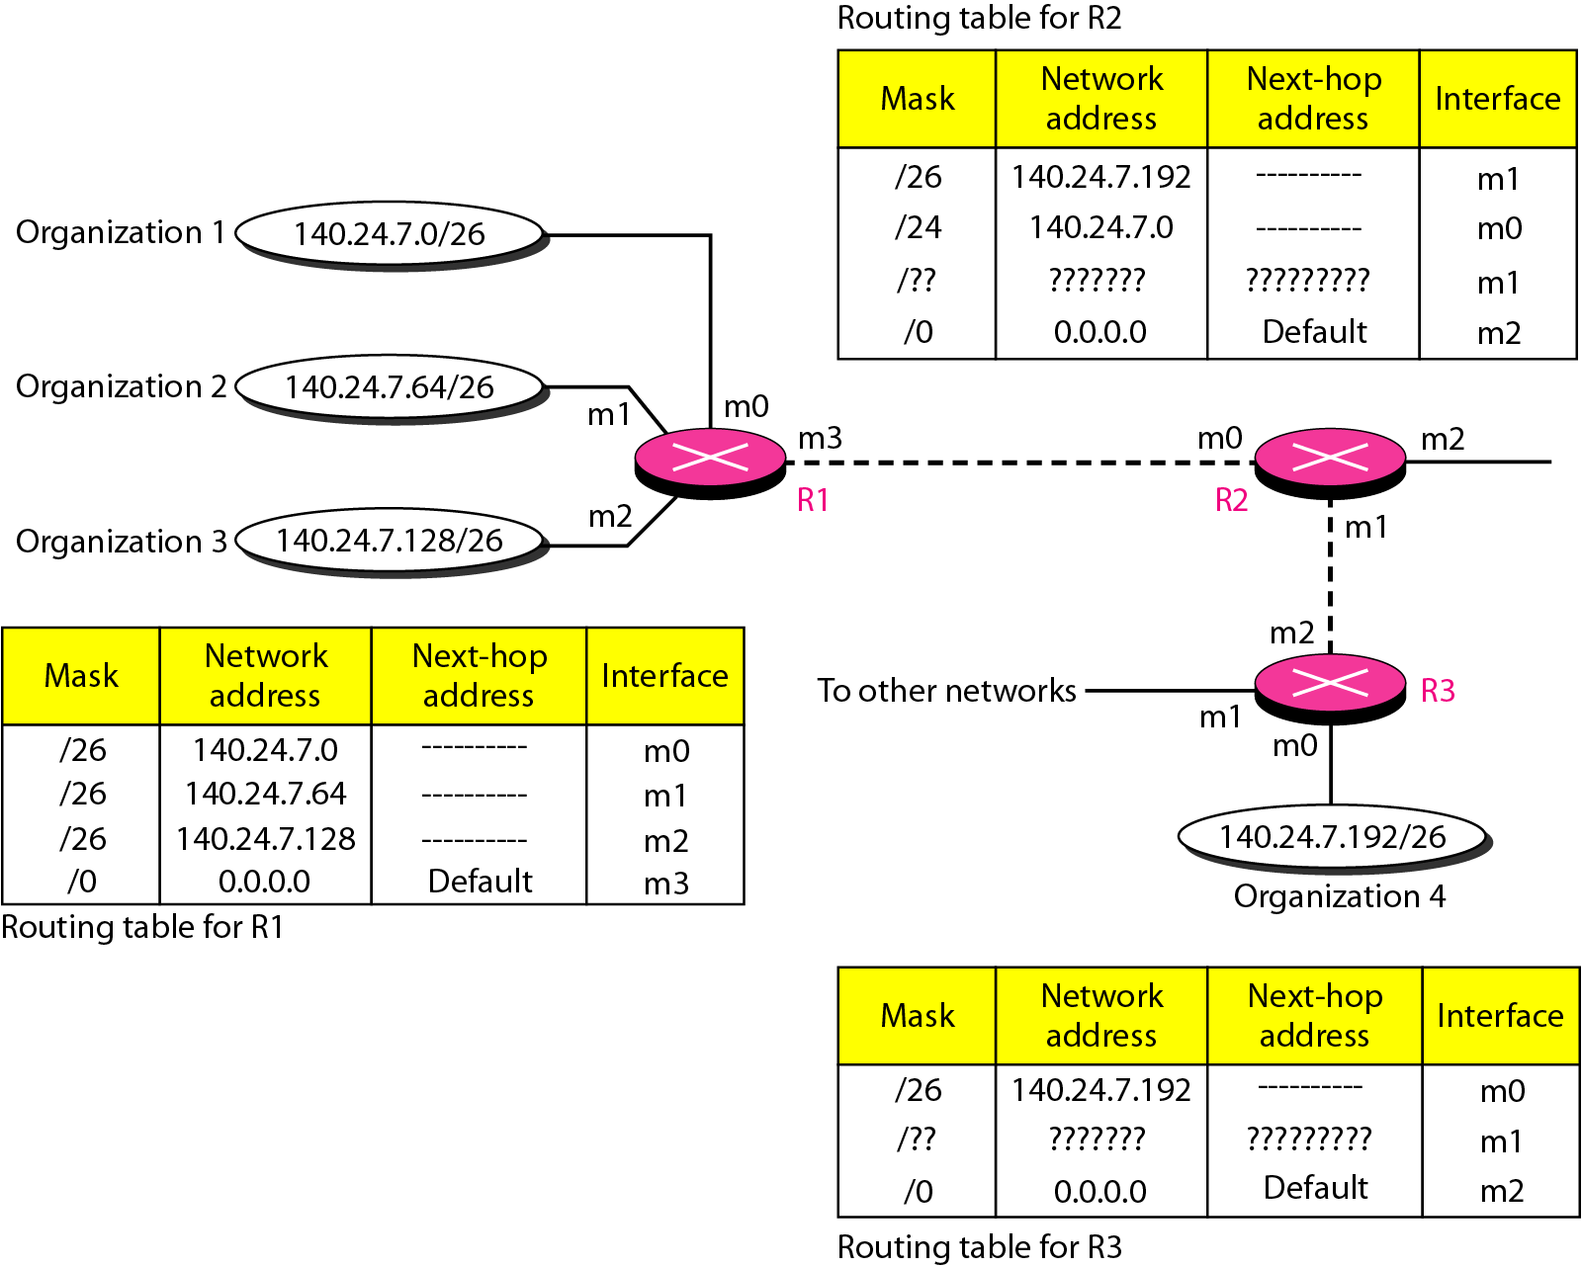
Longest Mask Matching

Slide 11
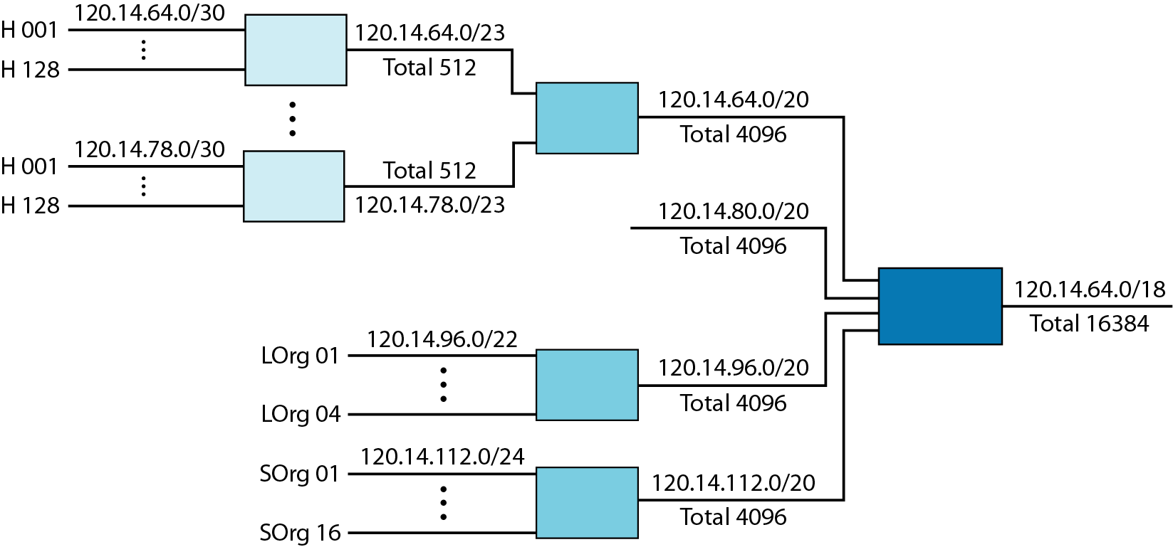
Hierarchical Routing
To solve the problem of gigantic routing tables

Slide 12
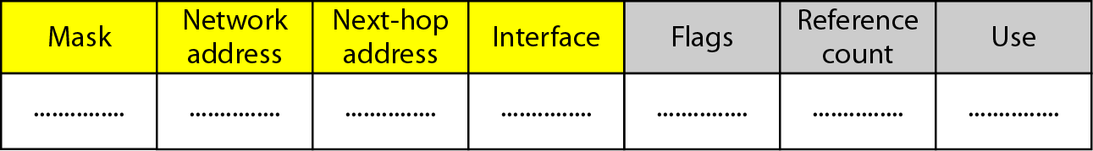
Routing Table
Static routing table: created manually
Dynamic routing table: updated periodically by using one of the dynamic routing protocols such as RIP, OSPF, or BGP
Common fields in a routing table
Flag: U(up), G(gateway), H(host-specific), D(added by redirection), M(modified by redirection)
Reference count: number of users of this route at the moment
Use: the number of packets transmitted through this router for the corresponding destination

Slide 13
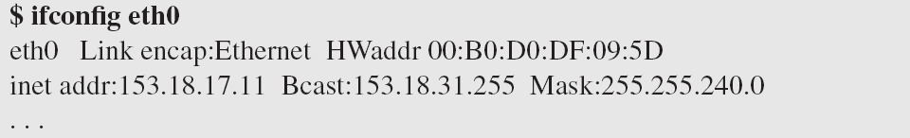
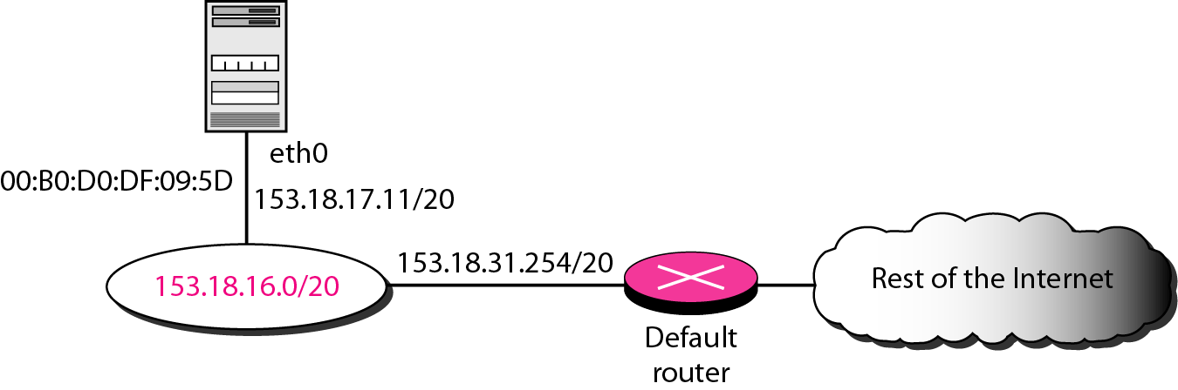
Utilities
To find the routing information and the contents of a routing table
netstat and ifconfig

Slide 14
Routing Protocols
A router consults a routing table when a packet is ready to be forwarded
The routing table specifies the optimum path for the packet: static or dynamic
Internet needs dynamic routing tables to be updated as soon as there is a change
Routing protocols is a combination of rules and procedures for dynamic routing tables
The routing protocols also include procedures for combining information received from other routers
Unicast routing and multicasting routing
RIP (Routing Information Protocol), OSPF (Open Shortest Path First), BGP (Border Gateway Protocol)

Slide 15
Optimization
Which of the available pathways is the optimum pathway ?
One approach is to assign a cost for passing through a network, called metric
Total metric is equal to the sum of the metrics of networks that comprise the route
Router chooses the route with shortest (smallest) metric
RIP (Routing Information Protocol): hop count
OSPF (Open Shortest Path First): allows administrator to assign a cost based on the type of service required
BGP (Border Gateway Protocol): criterion is the policy

Slide 16
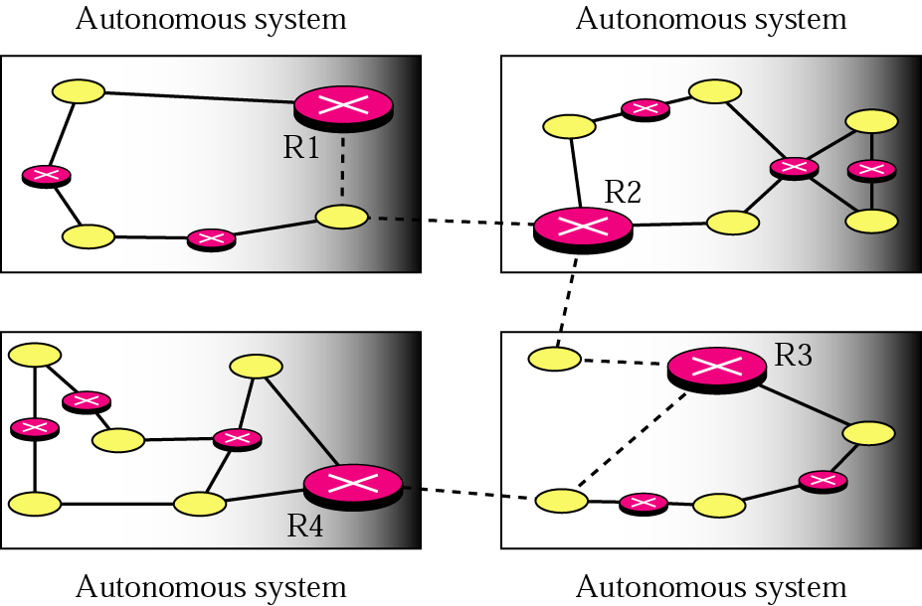
Intra- and Interdomain Routing
AS (autonomous system): A group of networks and routers under the authority of a single administration
Intradomain routing: inside an AS
Interdomain routing: between ASs
R1, R2, R3, and R4 use a intradomain and an interdomain routing protocol.
The other routes use only intradomain routing protocols

Slide 17
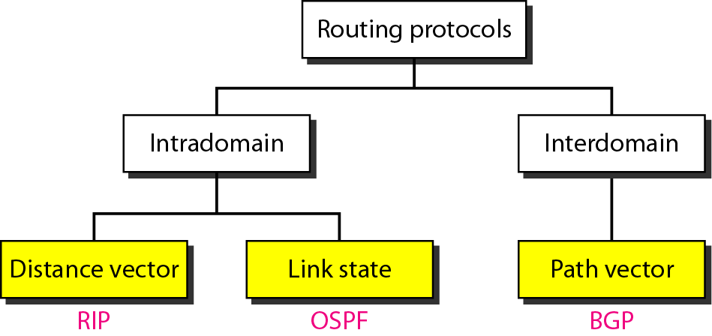
Popular (Unicast) Routing Protocols

Slide 18
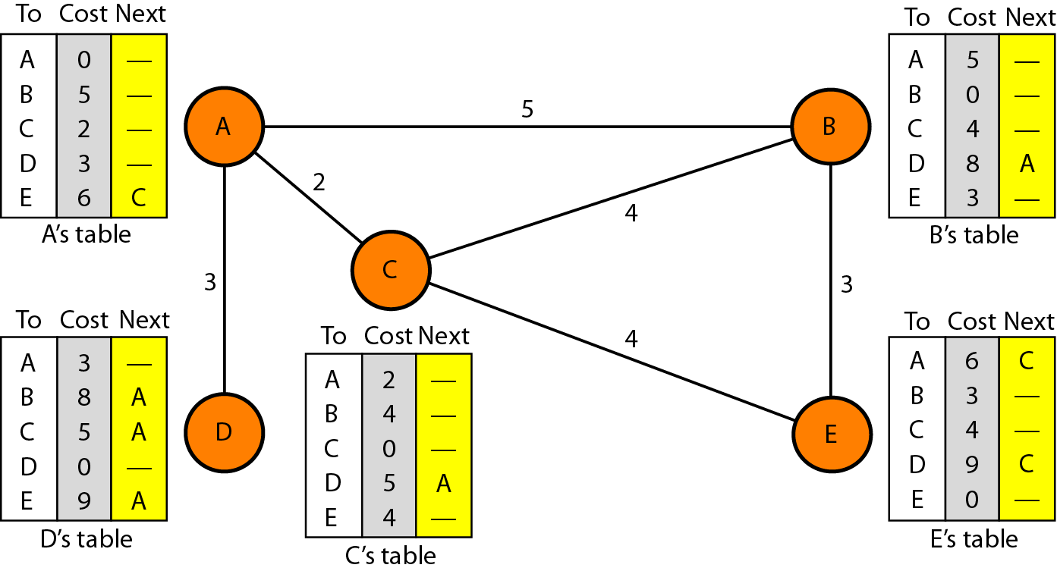
Distance Vector Routing
The least-cost route between any two nodes is the route with minimum distance
Each node maintains a vector(table) of minimum distances to every node
Distance vector routing table

Slide 19
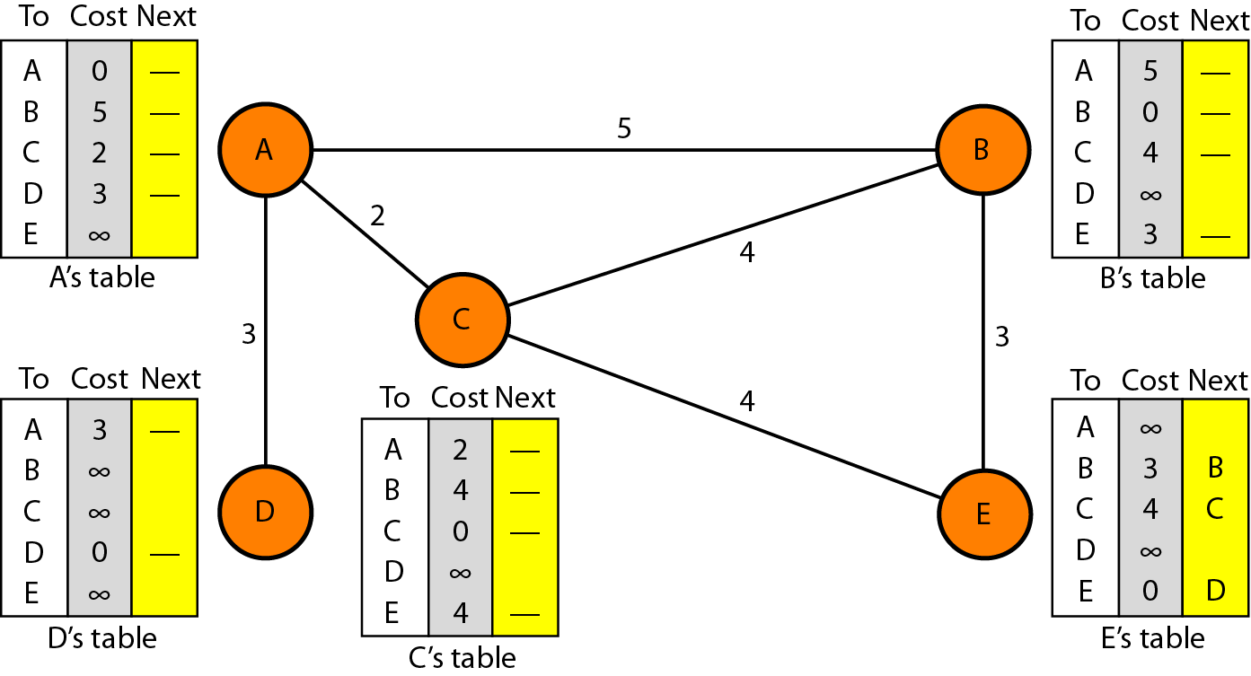
Distance Vector Routing: Initialization
At the beginning, each node can know only the distance between itself and its immediate neighbors

Slide 20
Distance Vector Routing: Sharing
In distance vector routing, each node shares its routing table with its immediate neighbors periodically and when there is a change

Slide 21
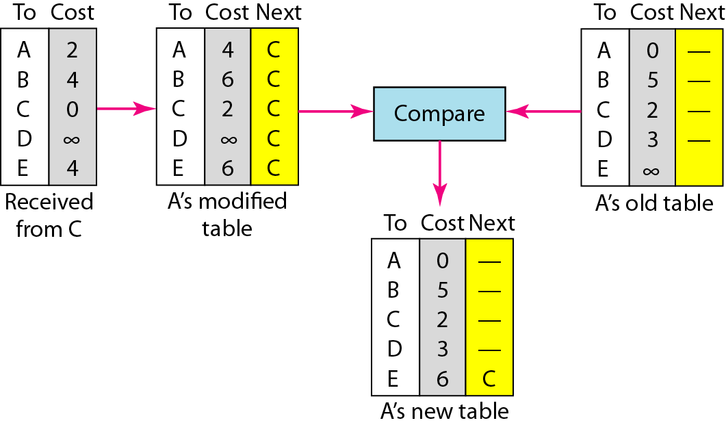
Distance Vector Routing: Updating
When a node receives a two-column table from a neighbor, it need to update its routing table
Updating rule:
Choose the smaller cost. If the same, keep the old one
If the next-node entry is the same, the receiving node chooses the new row

Slide 22
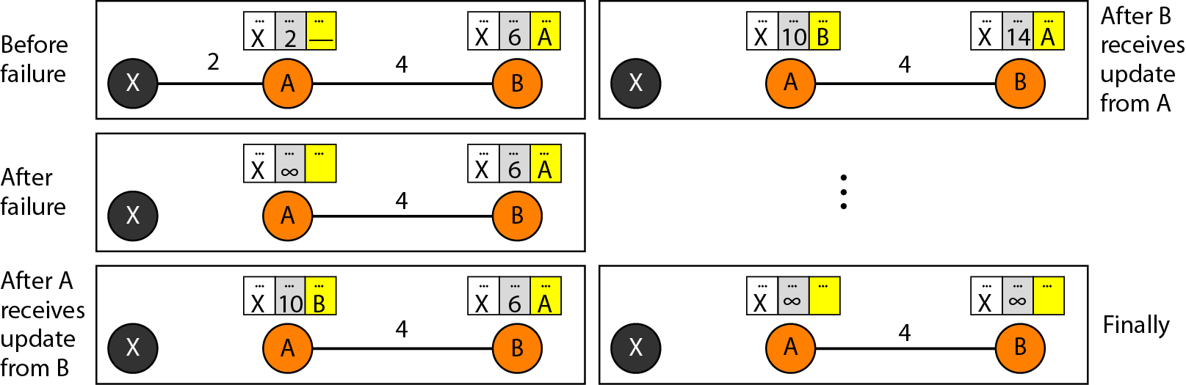
When to Share
Periodic update: A node sends its routing table, normally every 30 s
Triggered update: Anode sends its two-column routing table to its neighbors anytime there is a change in its routing table
Two-node instability

Slide 23
Two-Node Instability
Defining infinity: To redefine infinity to a smaller number, such as 100
Split horizon: Instead of flooding the table through each interface, each node sends only part of its table through each interface. Node B eliminates the last line of its routing table before it sends it to A
Split horizon and poison reverse: Node B can still advertise the value for X, but if the source of information is A, it can replace the distance with infinity as a warning: “Do not use this value, what I know about this route comes from you.”

Slide 24
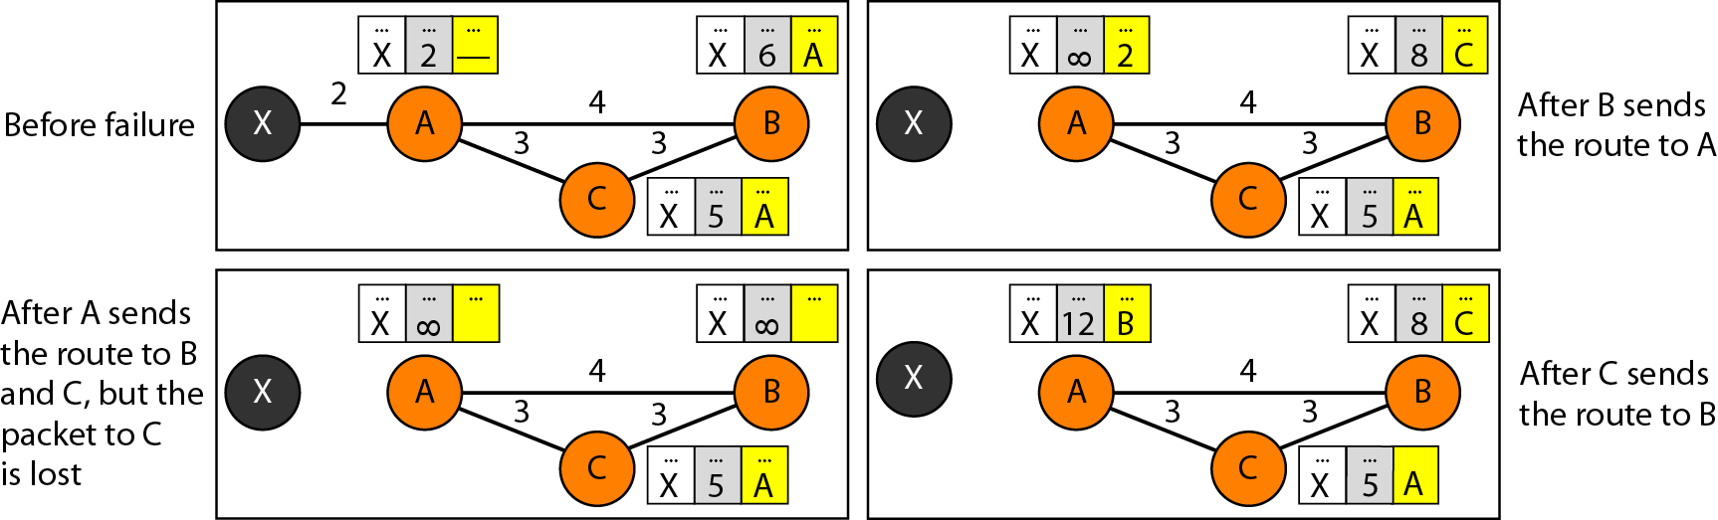
Three-Node Instability
If the instability is between three nodes, stability cannot be guaranteed.

Slide 25
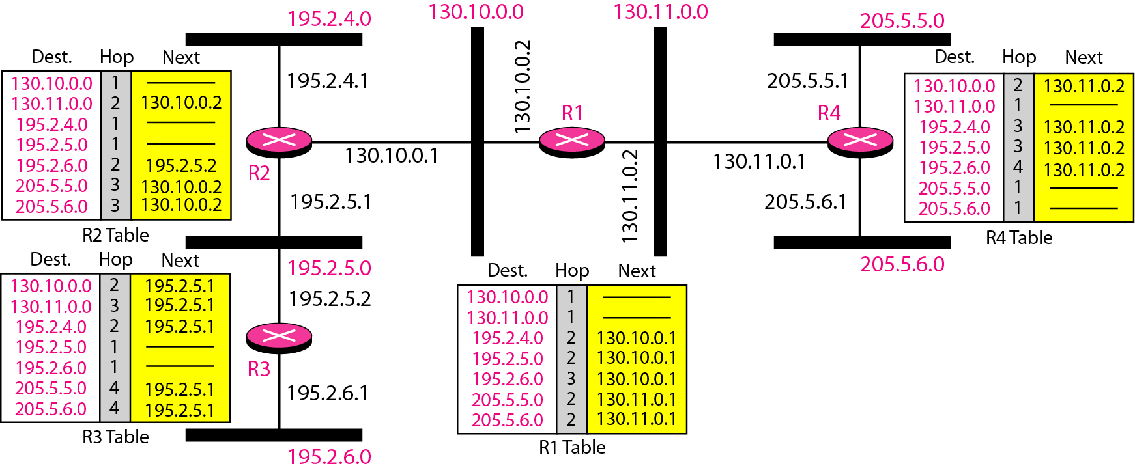
Routing Information Protocol
RIP: an intradomain routing protocol used inside an AS
Simple protocol based distance vector routing
Metric is simple, a hop count. The distance is defined as the number of links (networks) to reach the destination

Slide 26
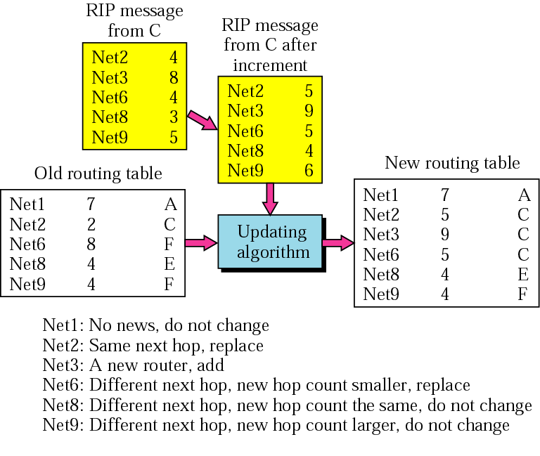
Example of RIP Updating

Slide 27
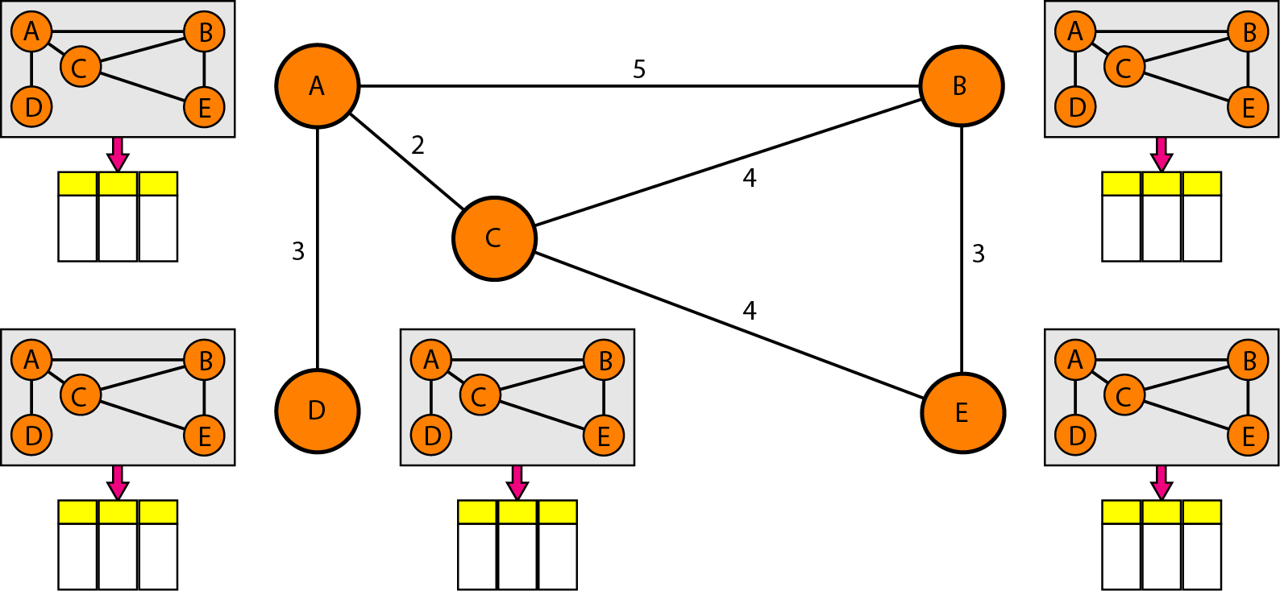
Link State Routing
Each node has the entire topology of the domain- the list of nodes and links, how they are connected including type, cost, and condition of the links(up or down)
Node can use Dijkstra’s algorithm to build a routing table

Slide 28
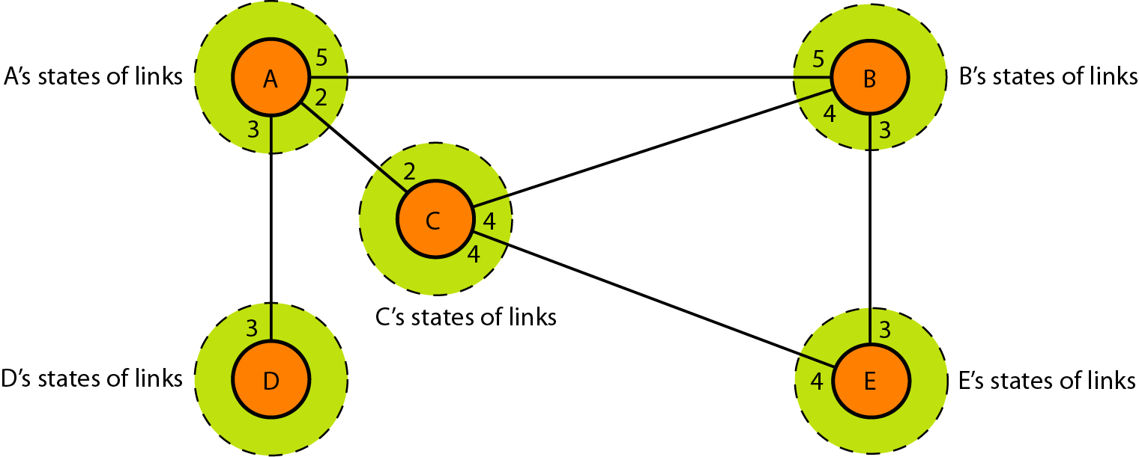
Link State Knowledge
Each node has partial knowledge: it know the state (type, condition, and cost) of its links. The whole topology can be compiled from the partial knowledge of each node

Slide 29
Building Routing Table
Creation of the states of the links by each node, called the link state packet (LSP)
Dissemination of LSPs to every other router, called flooding, in an efficient and reliable way
Formation of a shortest path tree for each node
Calculation of a routing table based on the shortest path tree
Creation of LSP
LSP contains node identity, the list of links (to make the topology), sequence number (to facilitate flooding and distinguish new LSPs from old ones
LSPs are generated (1) when there is a change in the topology of the domain, (2) on a periodic basis, normally 60 min or 2 h

Slide 30
Building Routing Table
Flooding of LSPs
The creating node sends a copy of the LSP out of each interface
A node compares it with the copy it may already have. If the newly arrived LSP is older than the one it has, it discards the LSP. If it is newer,
It discards the old LSP and keeps the new one
It sends a copy of it out of each interface except the one from which the packet arrived
Formation of shortest path tree: Dijkstra Algorithm
After receiving all LSPs, each node will have a copy of the whole topology. Need to find the shortest path to every other node
The Dijkstra algorithm creates a shortest path tree from a graph

Slide 31
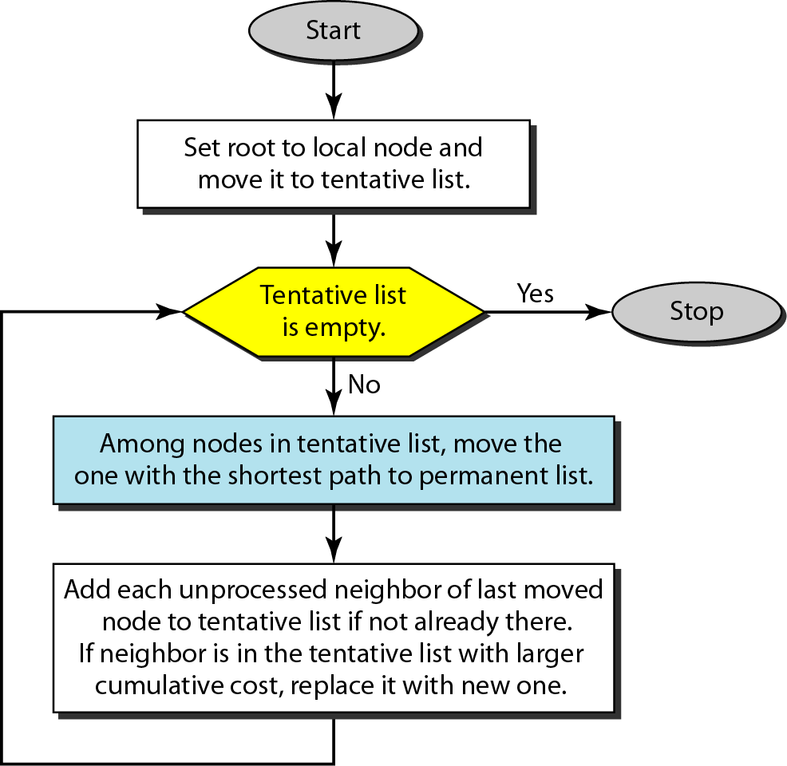
Dijkstra Algorithm

Slide 32
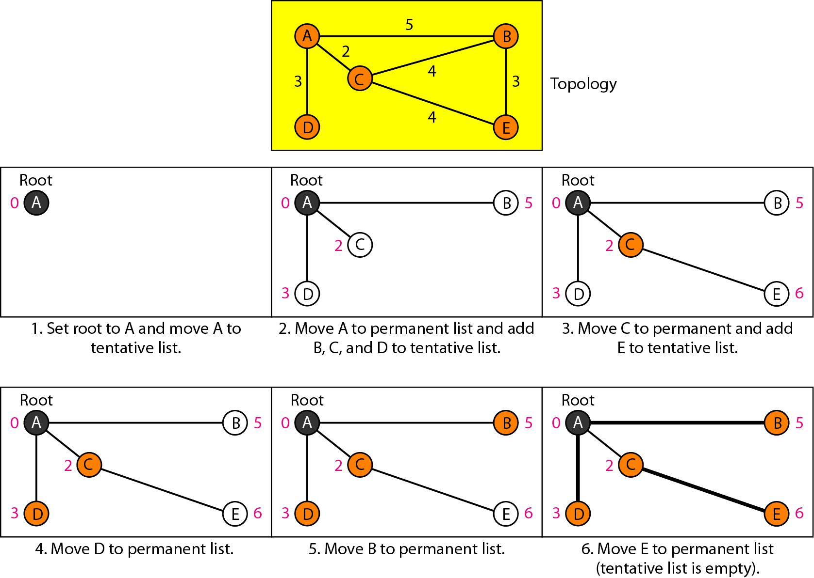
Example of Dijkstra Algorithm

Slide 33
Routing Table
Each node uses the shortest path tree protocol to construct its routing table
The routing table shows the cost of reaching each node from the root

Slide 34
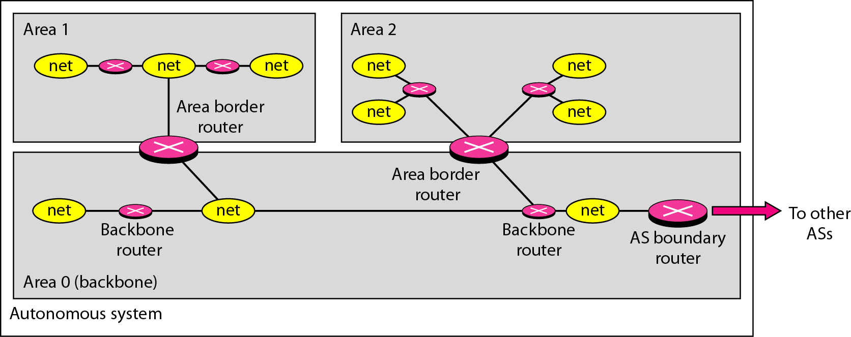
Open Shortest Path First (OSPF)
Popular intradomain routing protocol based on link state routing
To handle routing efficiently and in a timely manner, OSPF divides an autonomous system into area
Area is a collection of network, hosts, and routers all contained within an AS
AS can also be divided into many different areas
Area border gateway, backbone router, virtual link

Slide 35
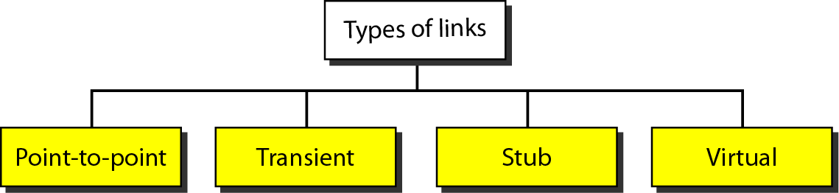
Metric
The OSPF allows the administrator to assign a cost, called the metric, to each route
The metric can be based on a type of service (minimum delay, maximum throughput, and so on)
Types of Links

Slide 36
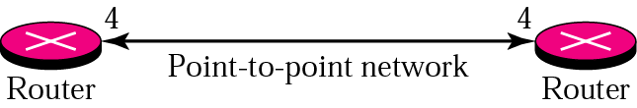
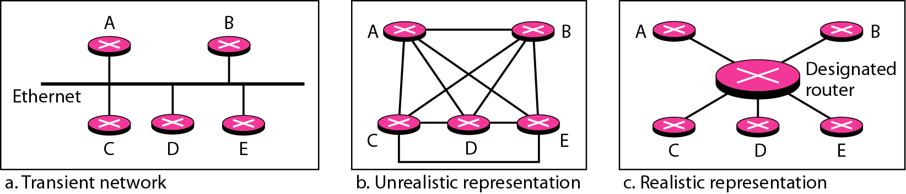
Point-to-Point Link
To connect two routers without any other host or router in between
Transient Link
A network with several routers attached to it

Slide 37
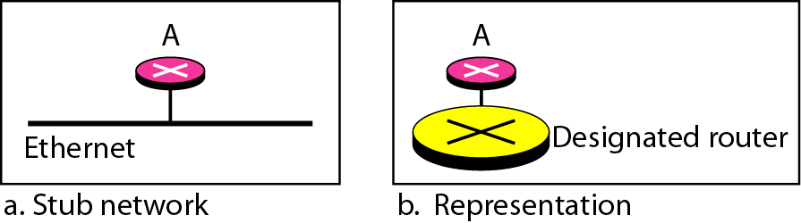
Stub Link
Stub link is a network that is connected to only one router
Virtual Link
Virtual link created for broken link by administrator

Slide 38
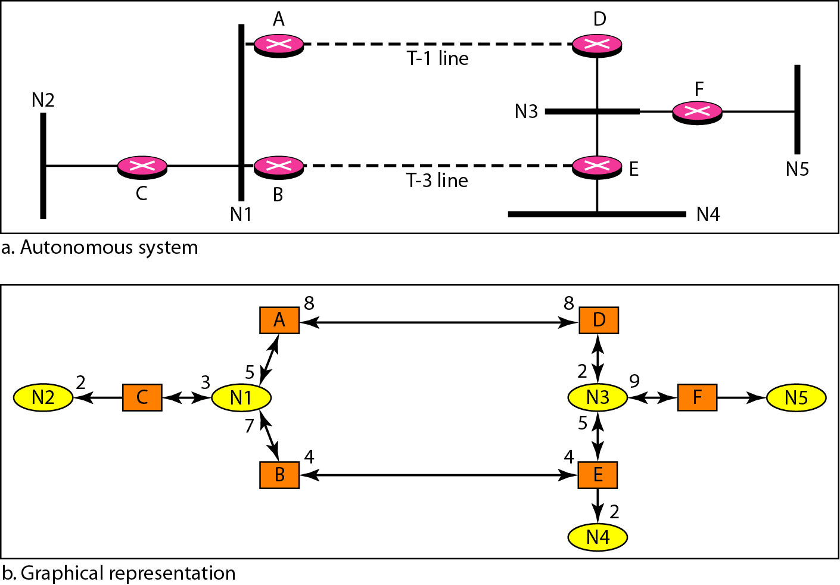
Graphical Representation of an Internet

Slide 39
Path Vector Routing
Distance vector routing is subject to instability if there are more than a few hops in the domain of operation
Link state routing needs a huge amount of resources to calculate routing tables. It also create heavy traffic because of flooding
Need for a third routing algorithm for interdomain routing, called path vector routing
Path vector routing is similar to distance vector routing
But, only speaker node creates a routing table and advertises it to speaker nodes in each AS
A speaker node advertises the path, not the metric of nodes

Slide 40
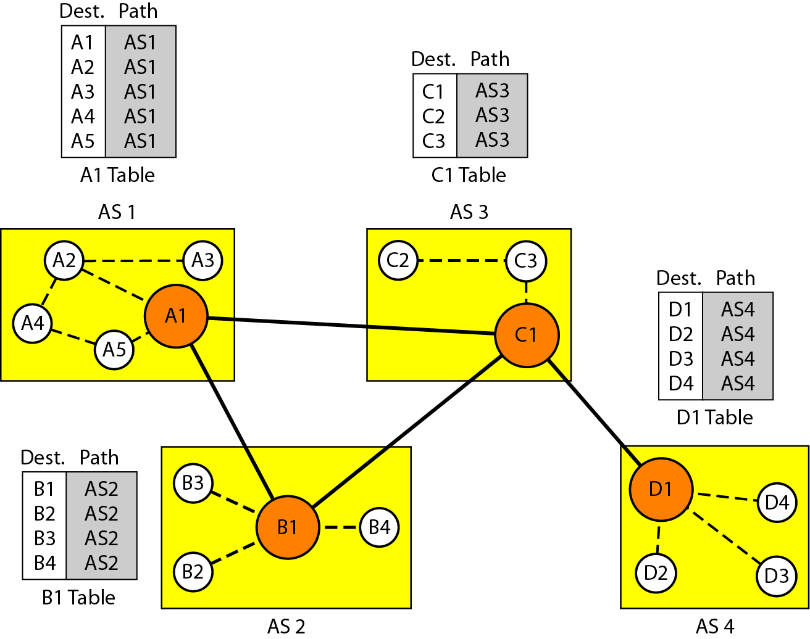
Path Vector Routing: Initialization

Slide 41
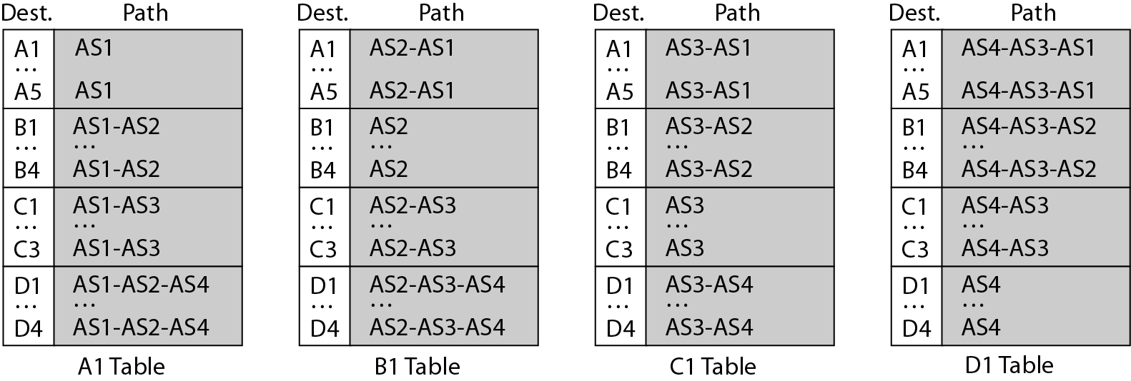
Path Vector Routing: Sharing and Updating
Sharing: Like distance vector routing, a speaker shares its table with immediate neighbors
Updating: When a speaker receives a two-column table from a neighbor, it updates its own table
Loop prevention
Policy routing
Optimum path

Slide 42
Border Gateway Protocol (BGP)
Interdomain routing protocol using path vector routing
Types of autonomous systems (ASs)
Stub AS: only one connection to another AS
Multihomed AS: more than one connection to other Ass, but still only a source or sink for data traffic
Transit AS: a multihomed AS that also allows transient traffic
Path attribute
Well-know attribute
Well-known mandatory attribute:
ORIGIN (source of the routing information)
AS_PATH (the list of ASs)
NEXT-HOP(the next router)
Well-known discretionary attribute
Optional attribute
Optional transitive attribute
Optional nontransitive attribute

Slide 43
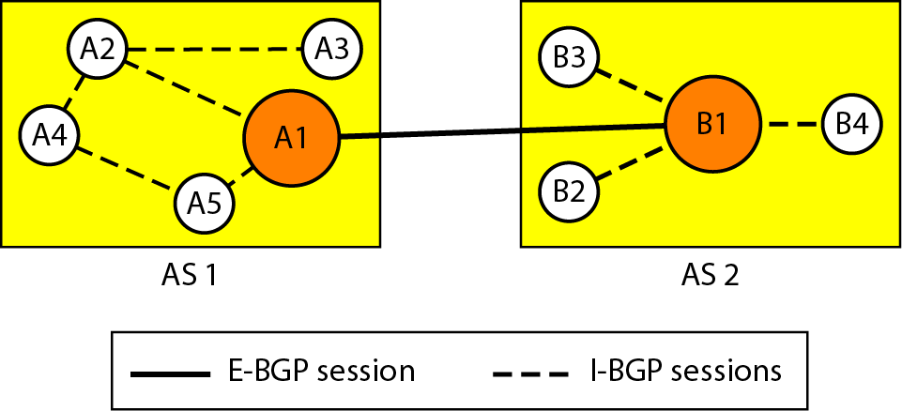
BGP Sessions
A session is a connection between BGP routers for the exchange of router information
To create a reliable environment, BGP uses the services of TCP as semipermanent connections
External and internal BGP
E-BGP sessions: used to exchange information between two speaker nodes belonging to two different ASs
I-BGP sessions: used to exchange information between two routers inside an AS

Slide 44
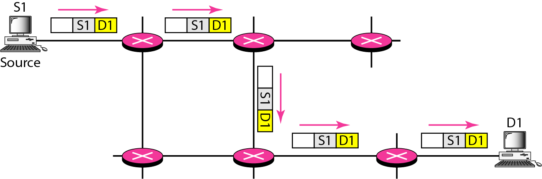
Unicasting
In unicasting, the router forwards the received packet through only one of its interfaces

Slide 45
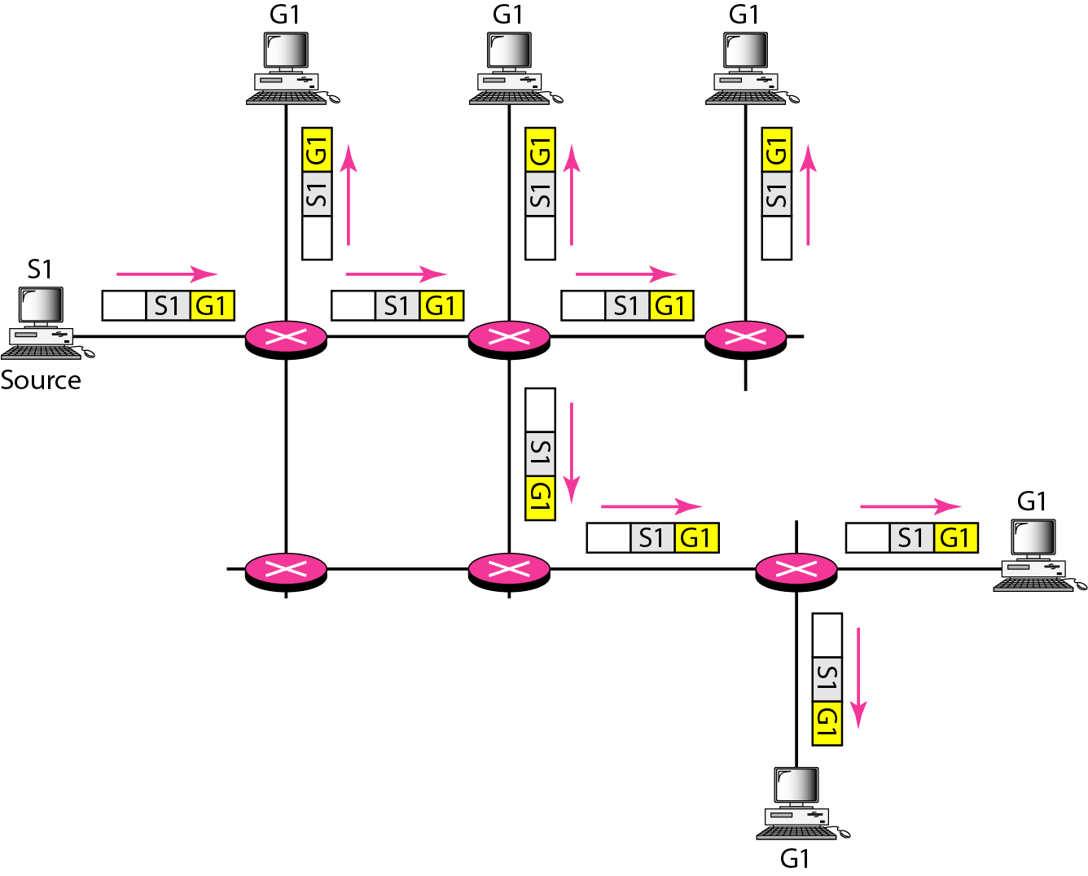
Multicasting
In multicast routing, the router may forward the received packet through several of its interfaces.
Broadcasting is a special case of multicasting

Slide 46
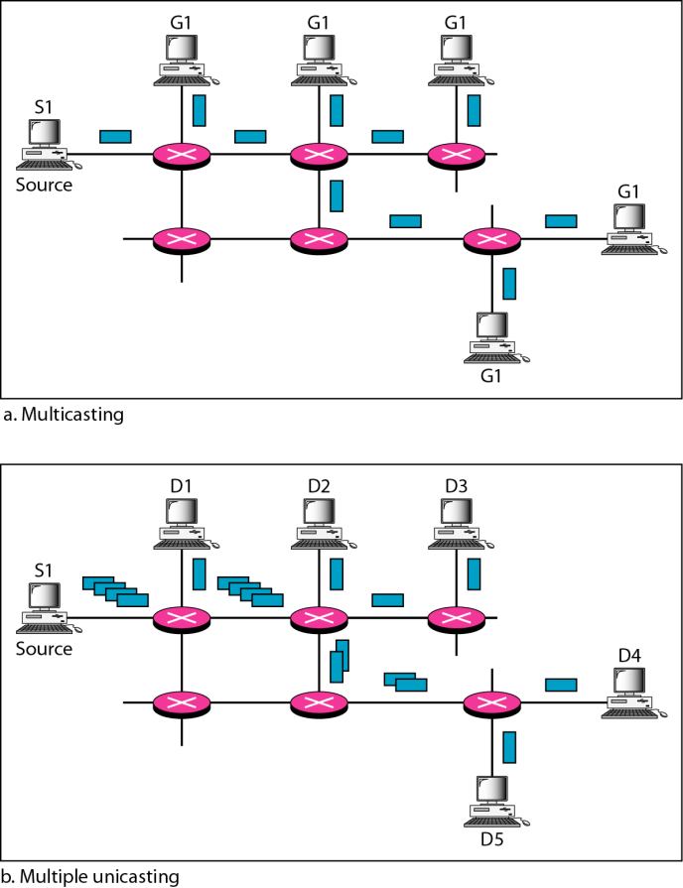
Multicasting vs. Multiple Unicasting
Emulation of multicasting through multiple unicasting is not efficient and may create long delays, particularly with a large group

Slide 47
Multicasting Applications
Access to distributed databases
Information dissemination
Dissemination of news
Teleconferencing
Distance learning

Slide 48
Multicast tree
Objectives of multicasting:
Every member of the group should receive one, and only one, copy of the multicast packet. Nonmember must not receive a copy
There must be no loops in routing
The path traveled from source to each destination must be optimal
In a source-based tree approach, the combination of source and group determines the tree (DVMRP, MOSPF, PIM-DM)
In the group-shared tree approach, the group determines the tree (CBT, PIM-SM)

Slide 49
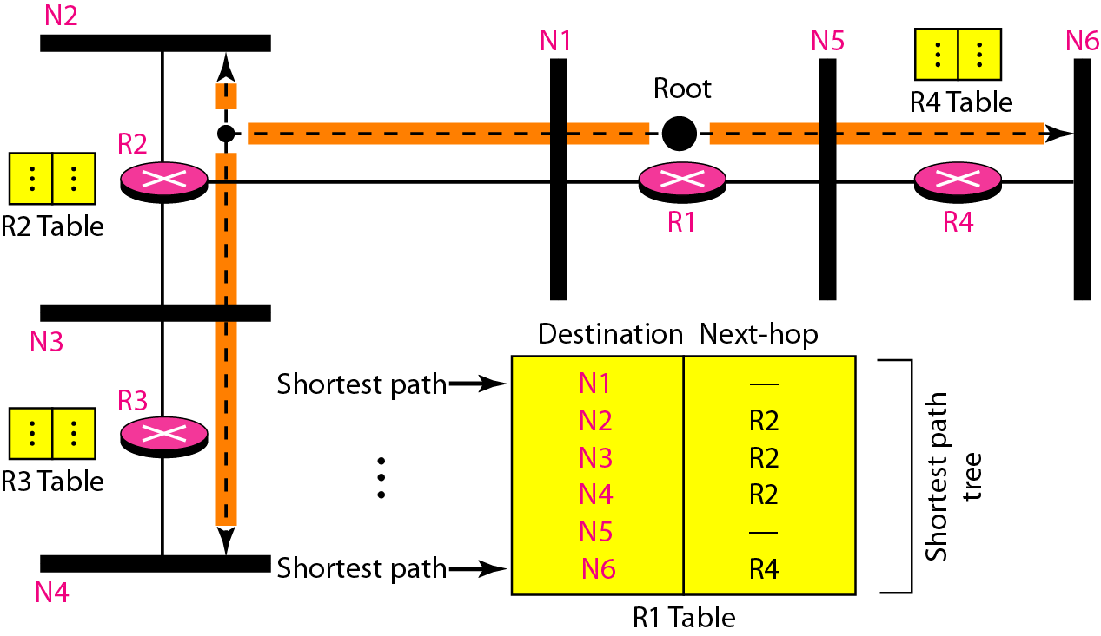
Multicast Routing
Optimal routing: Shortest path trees
Unicast Routing
Each router in the domain has a table that defines a shortest path tree to possible destinations

Slide 50
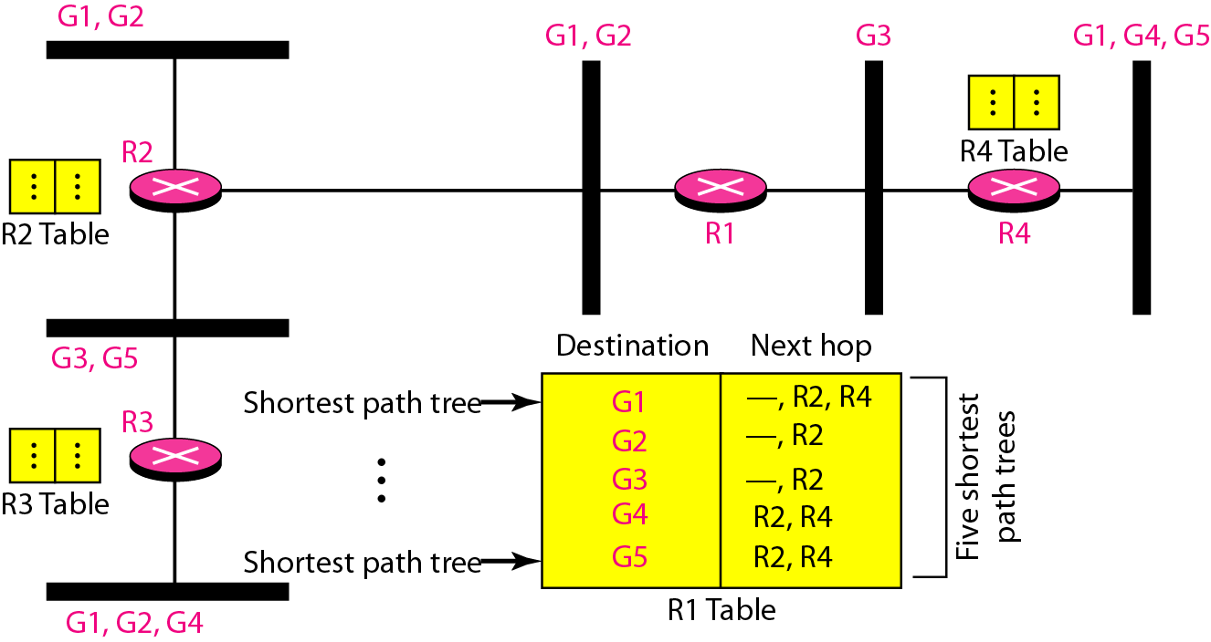
Shortest Path Tree
Multicast Routing
Each involved router needs to construct a shortest path tree for each group
Source-Based Tree and Group-Shared Tree
In the source-based tree approach, each router needs to have one shortest path tree for each group

Slide 51
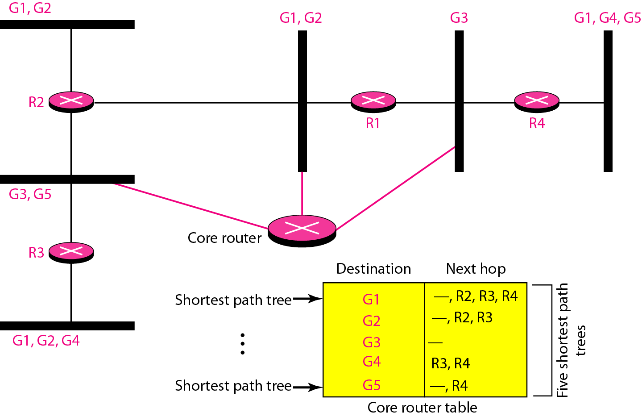
Shortest Path Tree
In the group-shared tree approach, only the core router, which has a shortest path tree for each group, is involved in multicasting

Slide 52
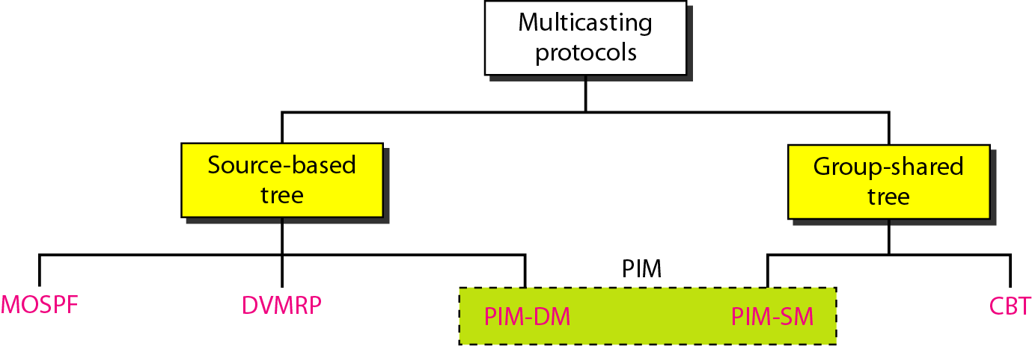
Multicast Protocols

Slide 53
Multicast Link State Routing: MOSPF
Multicast link state routing uses the source-based tree approach
n (the number of group) topologies and n shortest path trees made
Each router has a routing table that represents as many shortest path trees as there are groups
MOSPF is an extension of the OSPF protocol that uses multicast link state routing to create source-based trees
MOSPF requires a new link state update packet to associate the unicast address of a host with the group address or addresses the host is sponsoring
MOSPF is a data-driven protocol; the first time an MOSPF router see a datagram with a given source and group address, the router constructs the Dijkstra shortest path tree
Computer Networks
22-53

Slide 54
Multicast Distance Vector: DVMRP
Multicast distance vector routing uses the source-based trees, but the router never actually makes a routing table
Multicast routing does not allow a router to send its routing table to its neighbors. The idea is to create a table from scratch by using the information from the unicast distance vector tables
Process based on four decision-making strategies. Each strategy is built on its predecessor
Flooding
Reverse Path Forwarding (RPF)
Reverse Path Broadcasting (RPB)
Reverse Path Multicasting (RPM)
Computer Networks
22-54

Slide 55
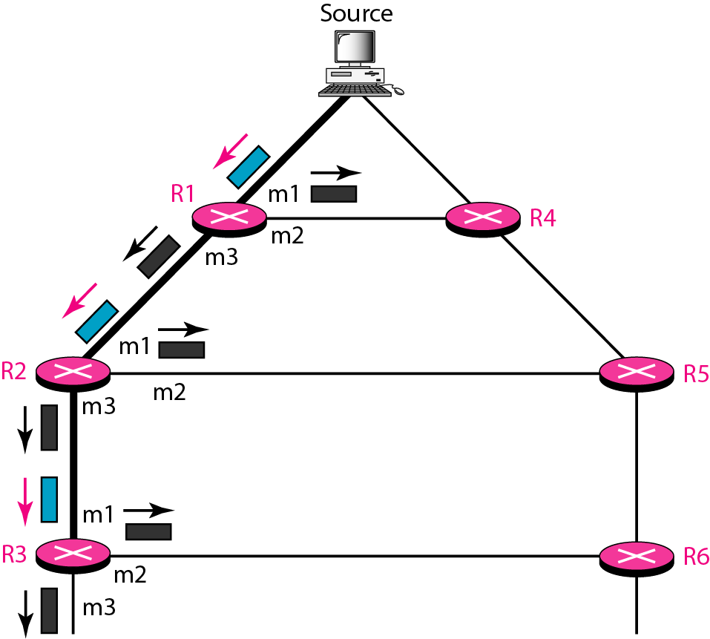
DVMRP: Strategies
Flooding broadcasts packets, but creates loops in the systems
Reverse path forwarding: RPF eliminates the loop in the flooding process

Slide 56
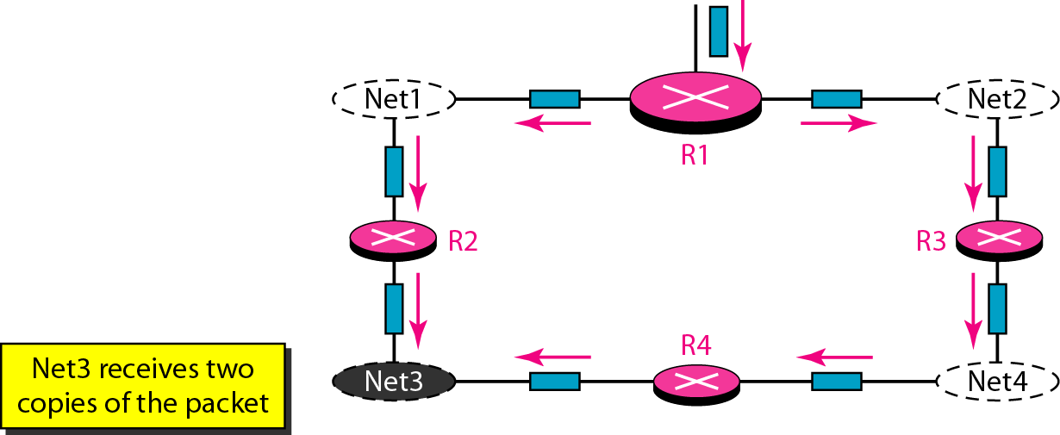
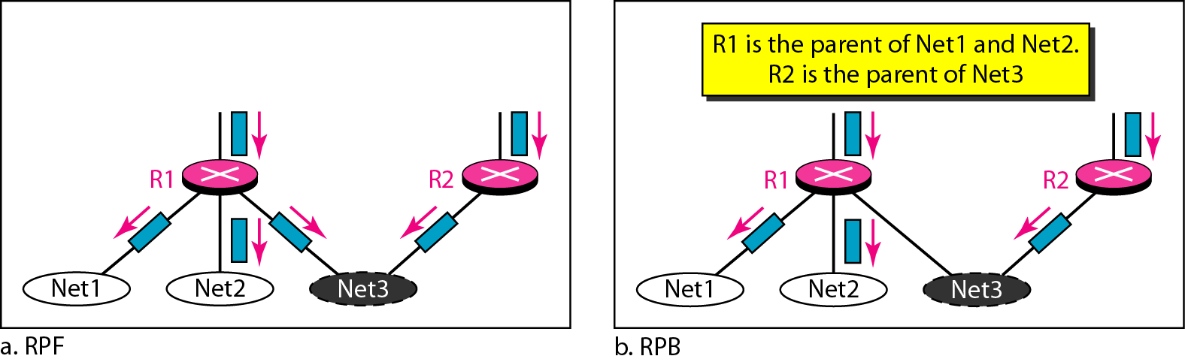
DVMRP: Strategies
Reverse path broadcasting: RPB creates a shortest path broadcast tree from the source to each destination. It guarantees that each destination receives one and only one copy of the packet
Problem with RPF
Computer Networks
22-56

Slide 57
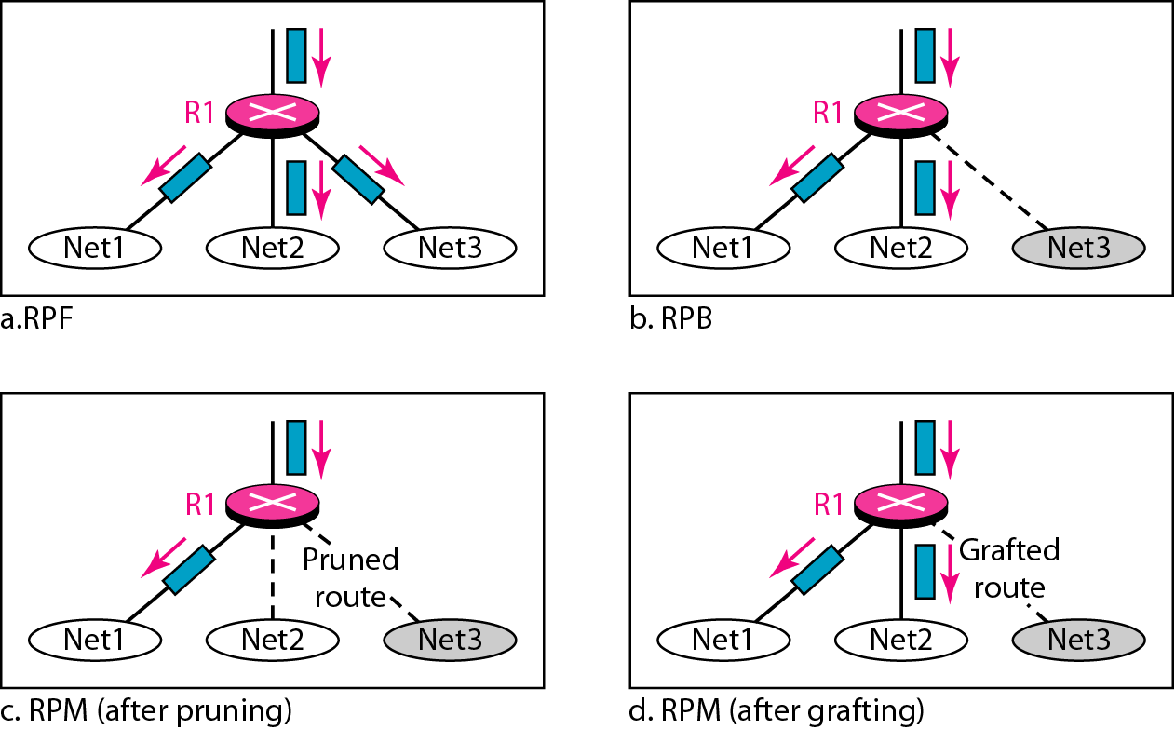
DVMRP: Strategies
Reverse path multicasting: RPM adds pruning and grafting to RPB to create a multicast shortest path tree that supports dynamic membership changes
Computer Networks
22-57

Slide 58
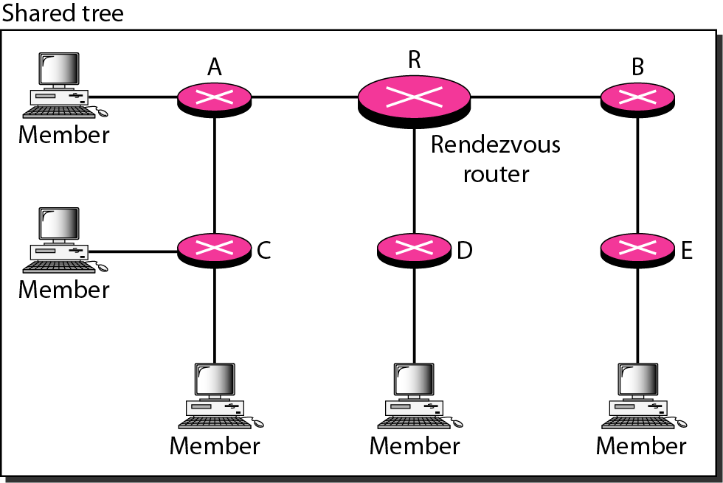
Core-Based Tree (CBT)
CBT is a group-shared protocol that uses a core as the root of the tree
AS is divided into regions, and core (center router or rendezvous router) is chosen for each region
Each router sends a unicast join message to rendezvous router
When the rendezvous router has received all join messages from every member of the group, the tree is formed

Slide 59
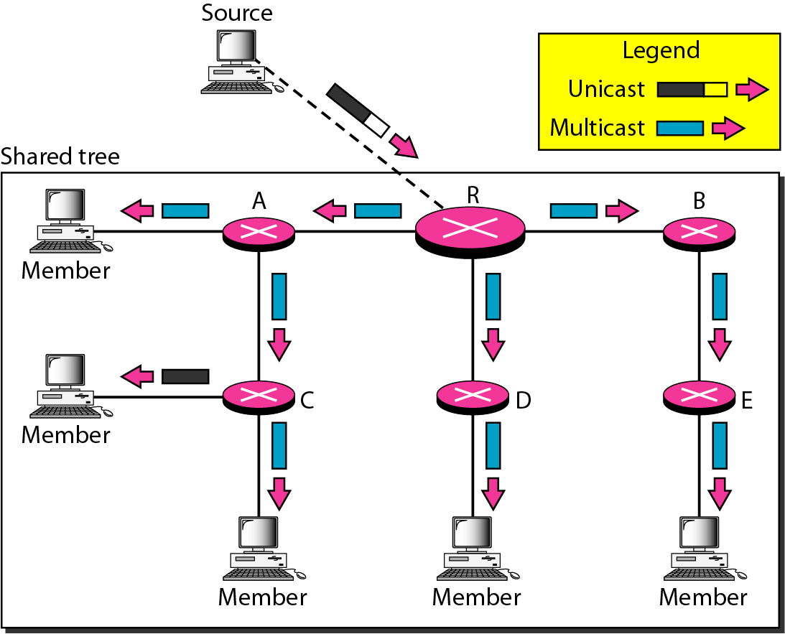
Sending Multicast Packets
The source sends the multicast packet (encapsulated in a unicast packet) to the core router. The core router decapsulates the packet and forwards it to all interested hosts. Each router that receives the multicast packet, in turn, forwards it to all interested ports

Slide 60
Protocol Independent Multicast (PIM)
PIM-DM (Dense Mode) and PIM-SM (Sparse Mode)
PIM-DM is used in a dense multicast environment, such as a LAN
PIM-DM is a source-based tree routing protocol that uses RPF and pruning and grafting strategies for multicasting. However, it is independent of the underlying unicast protocol.
PIM-SM is used in a sparse multicast environment such as a WAN
PIM-SM is a group-shared routing protocol that has a rendezvous point as the source of the tree
PIM-SM is similar to CBT but uses a simpler procedure.

Slide 61
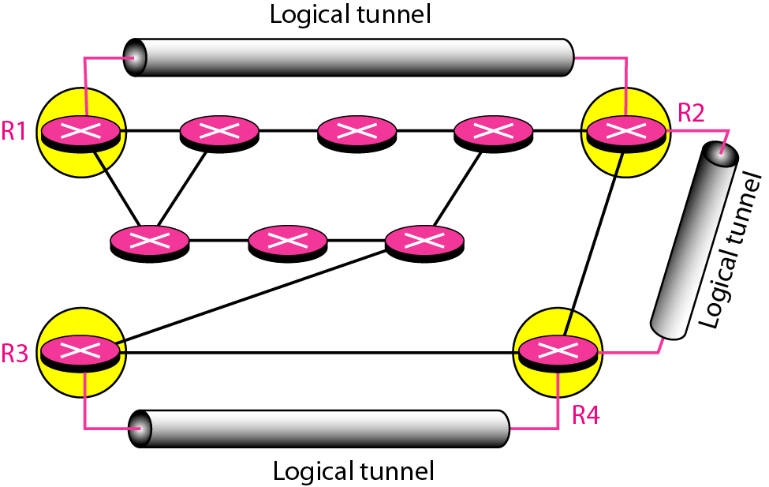
MBONE
To enable multicasting, we make a multicast backbone (MBONE) out of isolated routers, using of the concept of tunneling

Slide 62
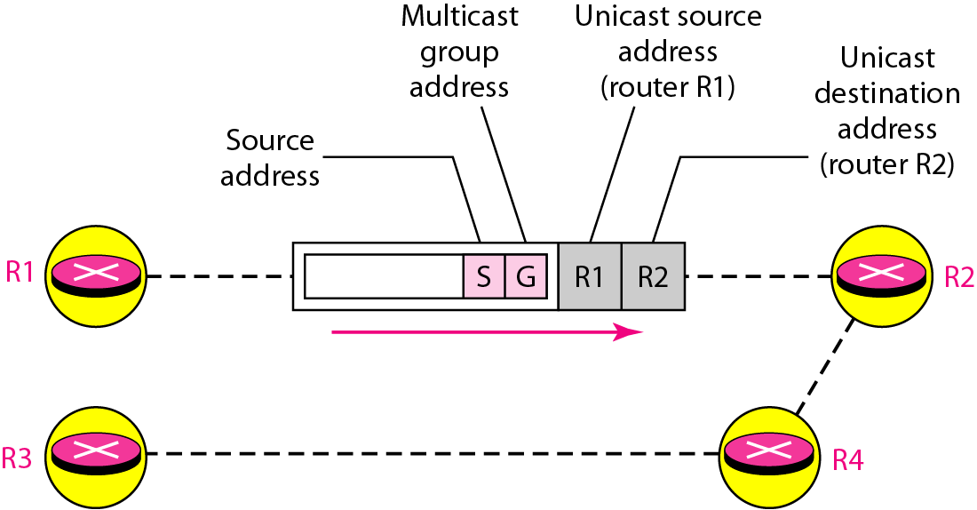
Logical Tunneling
A logical tunnel is established by encapsulating the multicast packet inside a unicast packet
The multicast packet becomes the payload (data) of the unicast packet
So far the only protocol supporting MBONE and tunneling is DVMRP

